Slide 1
Comparing the Impact of HEMP Electric Field Waveforms on a Synthetic Grid
Raymund Lee and Thomas J. Overbye
Texas A&M University
Notes:
I wrote a paper in which I simulate the effect of different HEMP electric field waveforms on a synthetic grid and compare the results.

Slide 2
Outline
Introduction to high altitude electromagnetic pulses (HEMP)
Background
Publicly available HEMP waveforms used in the paper
Conductivity models
Methodology
Converting waveforms to different conductivity model
Results
Summarize + discuss takeaways
Notes:
Background on some important concepts that you need to understand

Slide 3
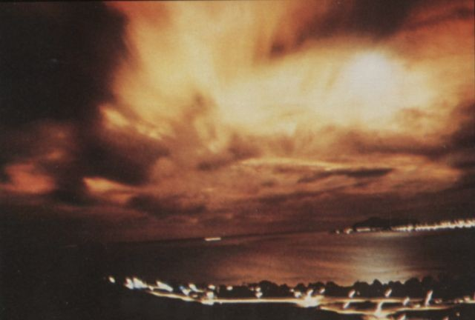
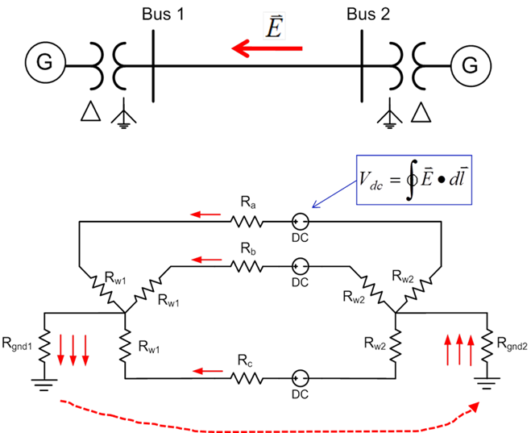
Introduction – HEMP and Grid Impacts
GRID IMPACTS
Transformer Heating
Nuclear explosion
Magnetic field fluctuation
Electric Field
Induced GIC on Lines
Transformer Saturation
var Loss
Generate Harmonics
Ground Conductivity
GIC = Geomagnetically Induced Currents
[1]
[3]
[2]
Notes:
This flow chart gives you a sense of what happens during a high altitude electromagnetic pulse.

Slide 4
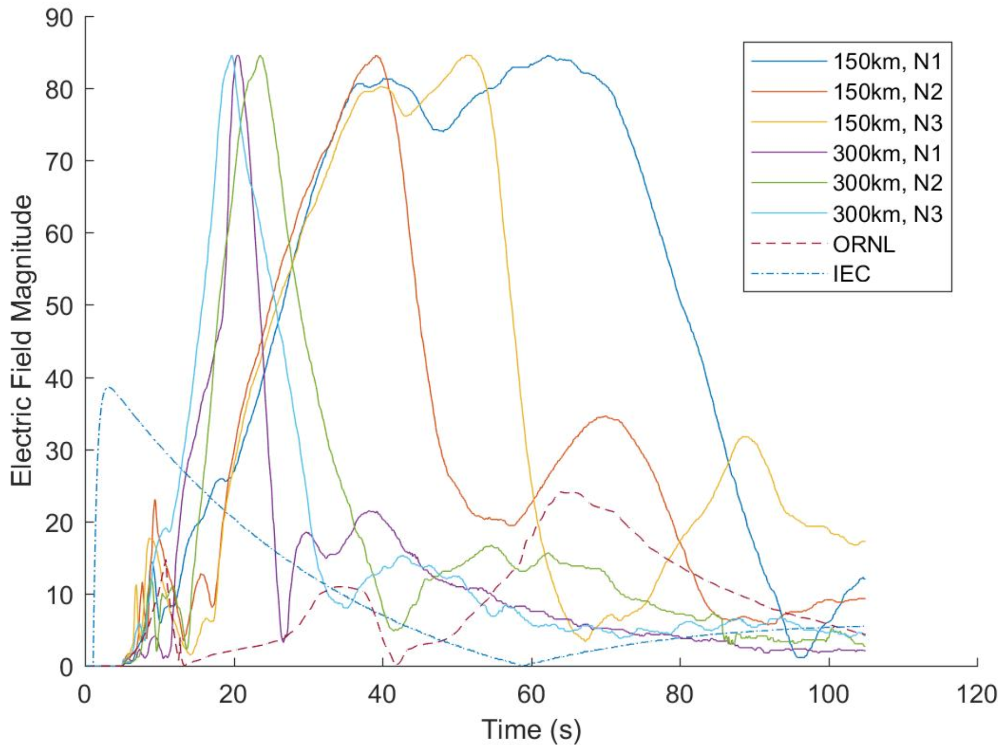
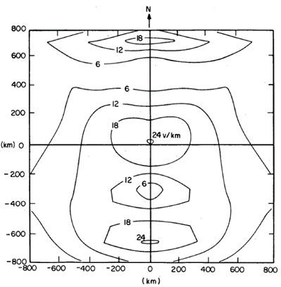
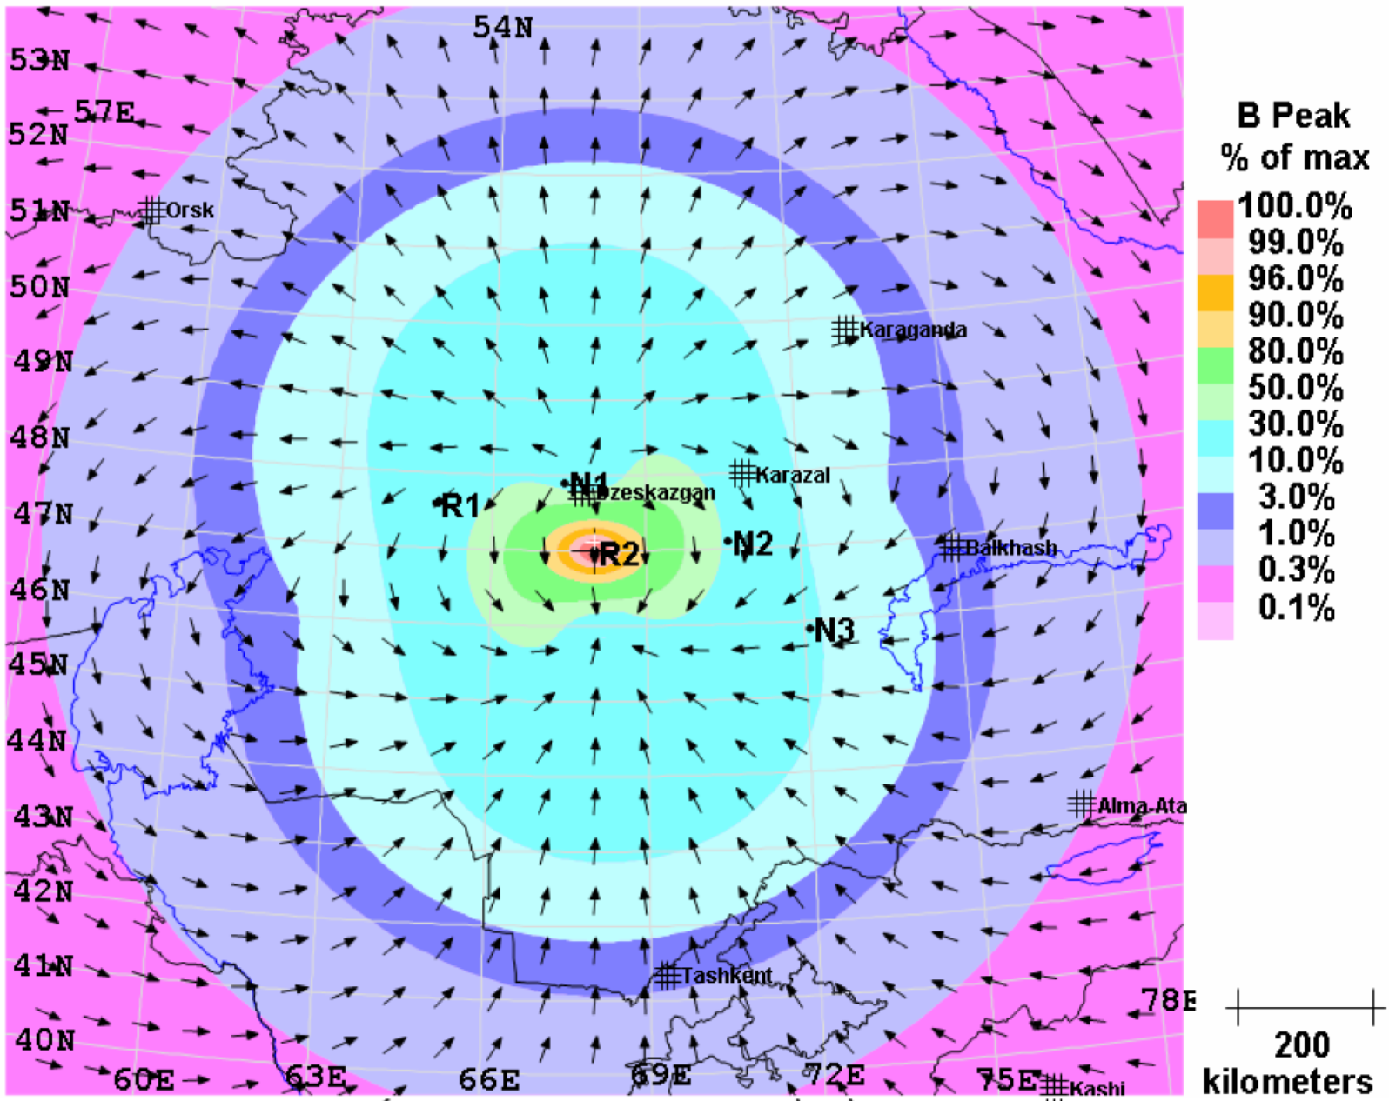
Background – HEMP Electric Field Waveforms
1985 – Oak Ridge National Labs (ORNL), 24 V/km
1996 – International Electrotechnical Commission (IEC)*, 40 V/km
2018 – EMP Commission, 6 waveforms, 84.57 V/km
*IEC waveform was published with no details on spatial variation
[5]
[4]

Slide 5
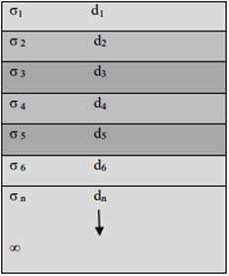
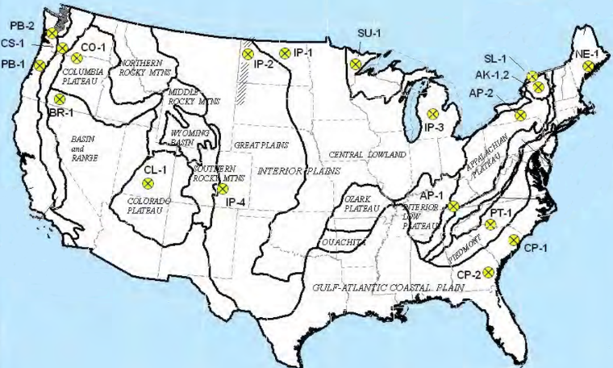
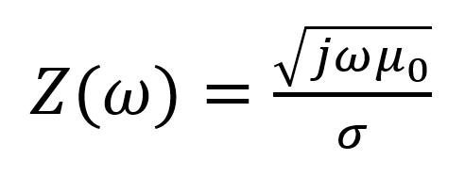
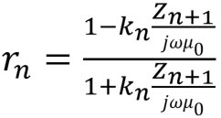
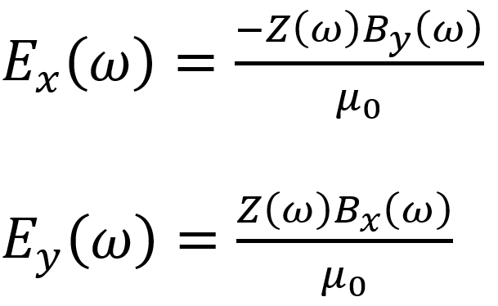
Background – Conductivity Models
Uniform Conductivity Model
1D Conductivity Model
σ = .001
Siemens/meter
Earth conductivity determines surface impedance, Z(ω)
**1D model has locational dependence!

Slide 6
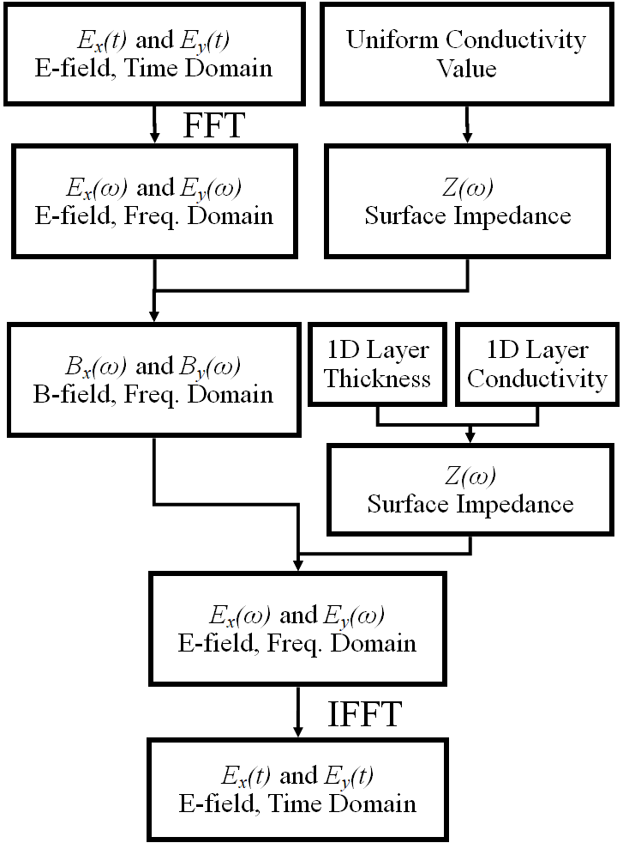
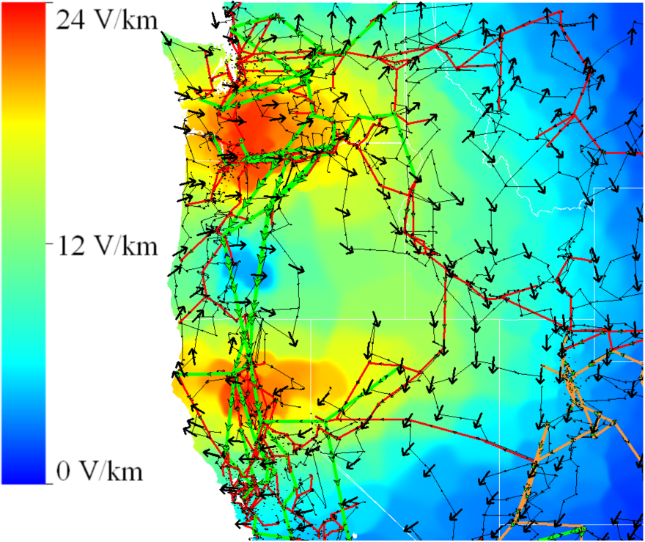
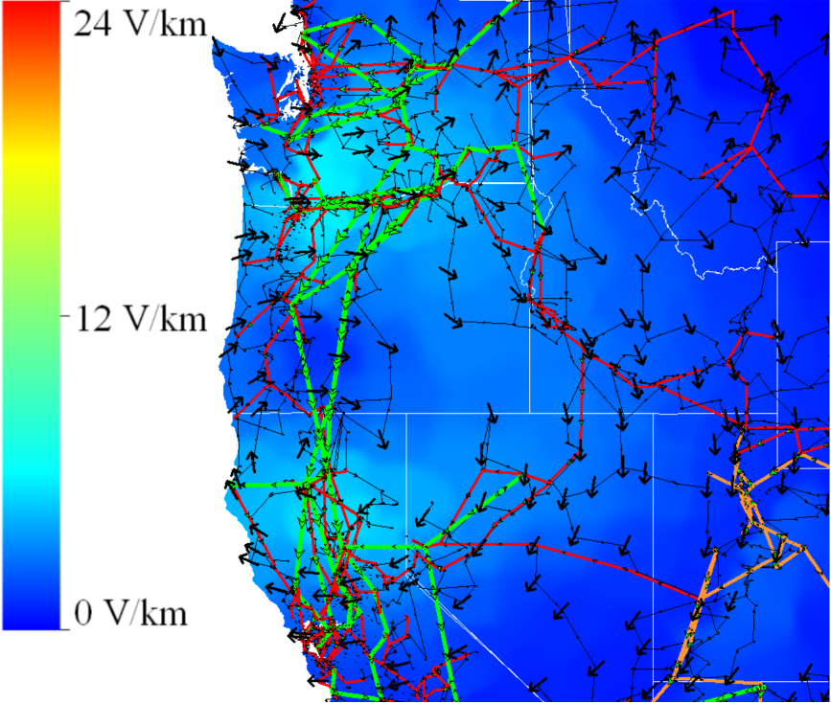
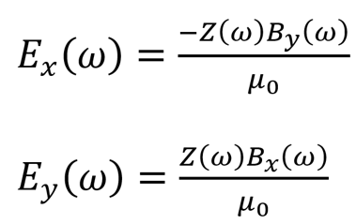
Methodology
Uniform Conductivity Model
1D Conductivity Model
ORNL HEMP Electric Field

Slide 7
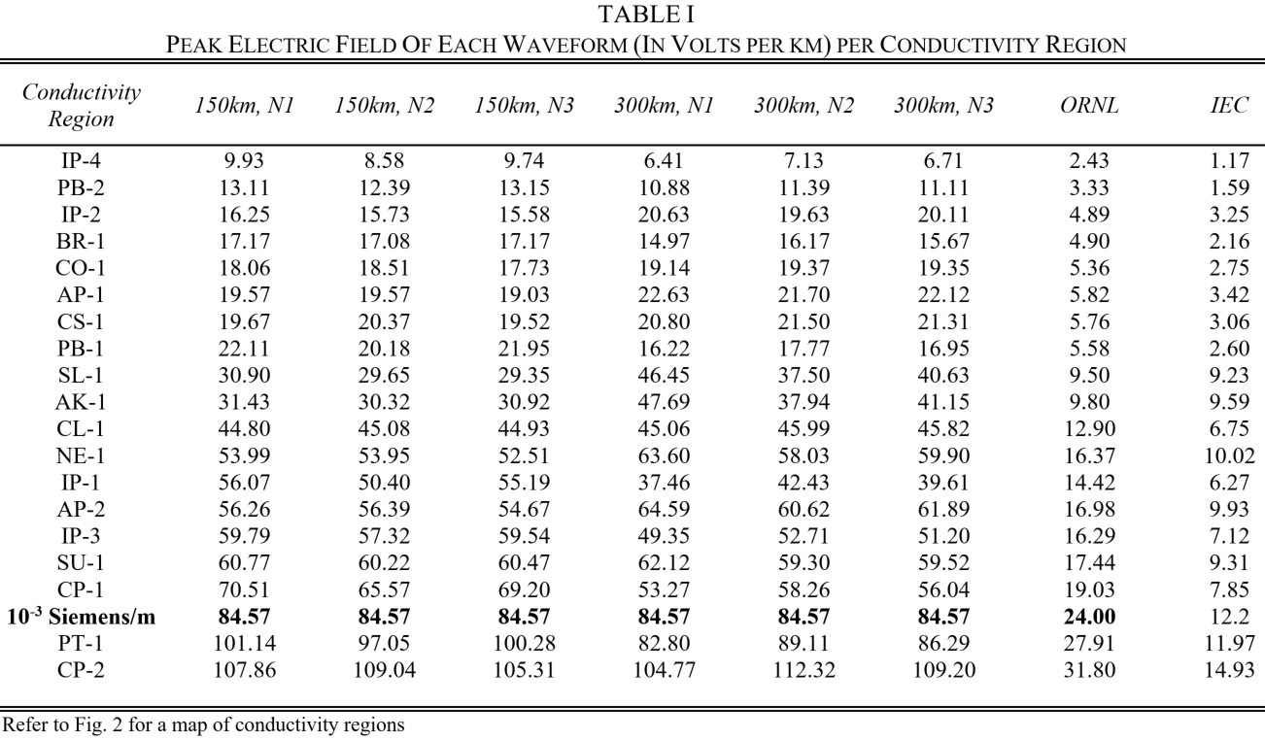
Results – Electric Fields Under 1D Model
Observation 1
Electric field magnitudes vary greatly between regions
Texas (CP-2) yielded a peak electric field 2.65 times larger than Fargo (IP-1) and 15.75 times larger than Bismarck (IP-4)
Observation 2
Waveforms could be affected much differently by the same region
Waveform 300km, N1 is 1.5 times larger than 150km, N1 under the same conductivity region SL-1

Slide 8
Background – Modeling the Impact of HEMPs
Find induced voltage on each line:
Use system topology and resistance parameters to find GIC flow:
Determine reactive power loss at each transformer:
[2]

Slide 9
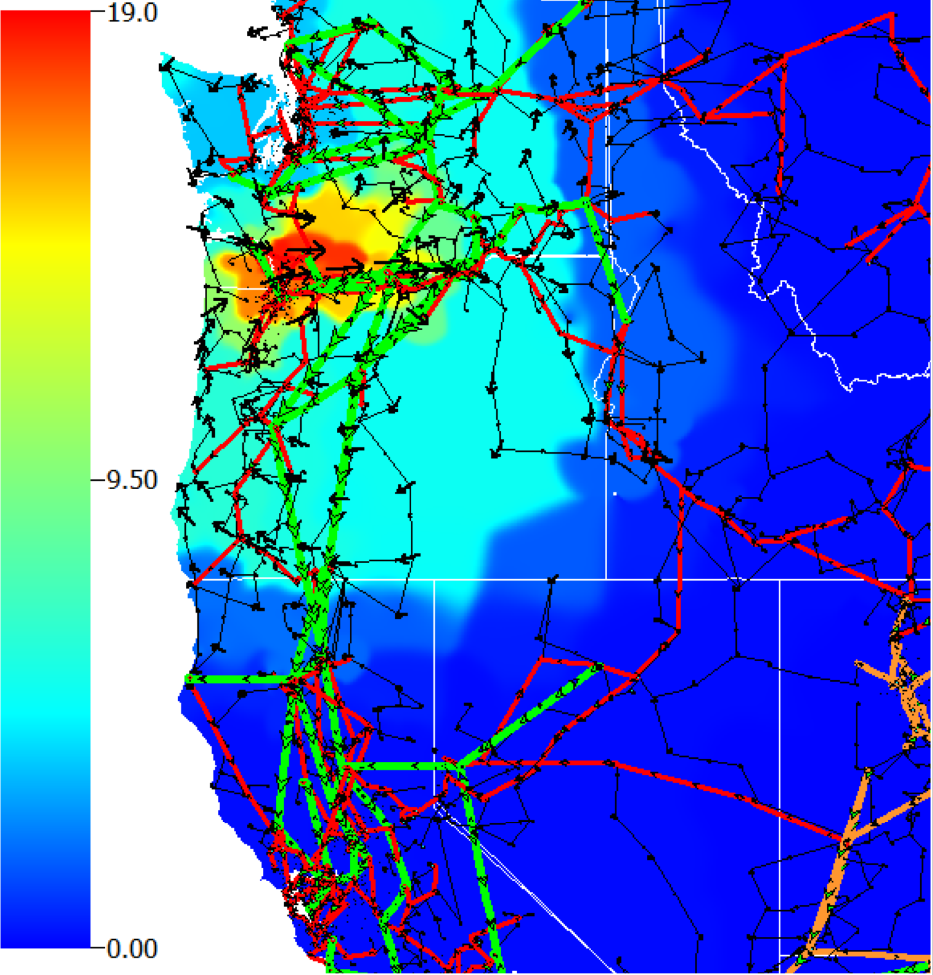
Results – HEMP Impacts on Synthetic Grid
Used 10,000 bus synthetic grid
Has 2,381 transformers
Applied HEMP electric field to center latitude and longitude of ${46.1}^{°}$N, ${−121.6}^{°}$W
150km, N1 HEMP electric field under the 1D conductivity model at its peak intensity

Slide 10
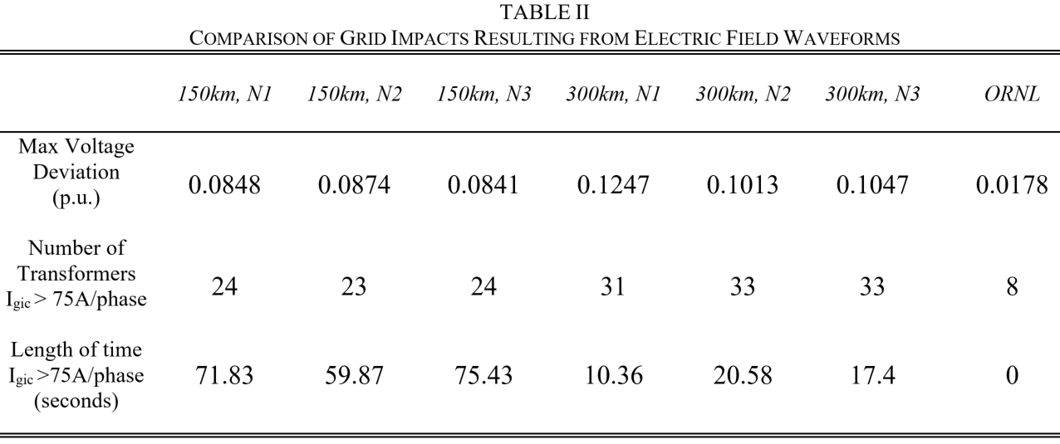
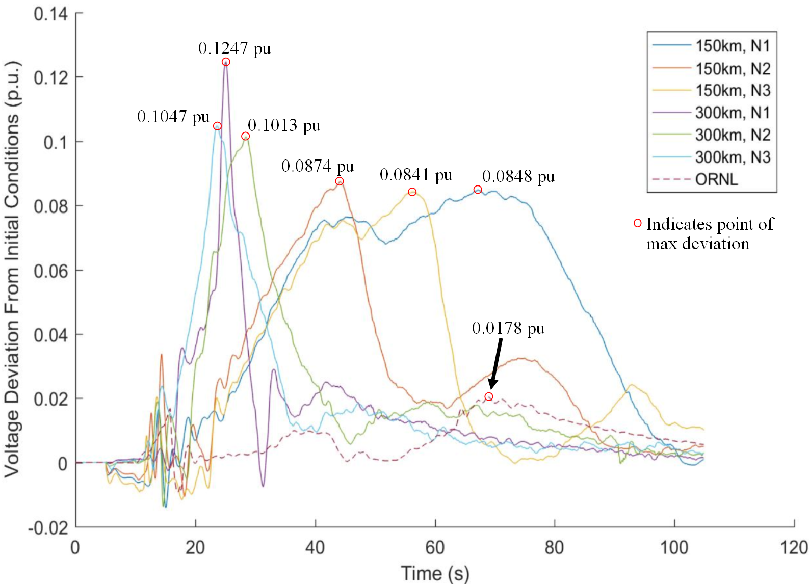
Results – HEMP Impacts on Synthetic Grid
Observation 3
High rise-time results in higher voltage drop
Observation 4
Sustained high levels of electric field result in sustained GIC’s

Slide 11
Summary
New HEMP electric fields originally published under the uniform model were converted to the 1D model
Determined electric field peak magnitudes for each conductivity region
Compared the effect of each waveform on a synthetic grid
Takeaway:
When evaluating the vulnerability of a power system to HEMP, use multiple waveforms.
Observation 1
Electric field magnitudes vary greatly between regions
Observation 2
Waveforms could be affected much differently by the same region
Observation 3
High rise-time results in higher voltage drop
Observation 4
Sustained high levels of electric field result in sustained GIC’s

Slide 12
Special Thanks
Funded under Bonneville Power Administration (BPA) project TIP 359
Questions?

Slide 13
Extra Slides

Slide 14
Image Sources
[1] https://en.wikipedia.org/wiki/Nuclear_electromagnetic_pulse
[2] https://www.powerworld.com/products/simulator/add-ons-2/simulator-gic
[3] Craig Stiegemeier, JASON Presentation, June 2011
[4] “Study to Assess the effects of Magnetohydrodynamic Electromagnetic Pulse on Electric Power System, Phase 1, Final Report,” Martin Marietta Energy Systems Inc. Oak Ridge National Labs. 1985.
[5] “Recommended E3 HEMP Heave Electric Field Waveform for the Critical Infrastructures,” Jul. 2017. Web Link: http://www.dtic.mil/dtic/tr/fulltext/u2/1051494.pdf
[6] "Application Guide: Computing Geomagnetically-Induced Current in the Bulk-Power System, " NERC, Dec. 2013. [Online]. Available: http://www.nerc.com/comm/PC/Geomagnetic%20Disturbance%20Task %20Force%20GMDTF%202013/GIC%20Application%20Guide%202 013-approved.pdf
[7] P. Fernberg, “One-Dimensional Earth Resistivity Models for Selected Areas of Continental United States & Alaska,” EPRI, Palo Alto, CA, Technical Results (1026430), 2012.
[8]

Slide 15
Background – Conductivity Models
Uniform Conductivity Model
1D Conductivity Model
σ = .001
Siemens/meter
Earth conductivity determines surface impedance, Z(ω)

Slide 16
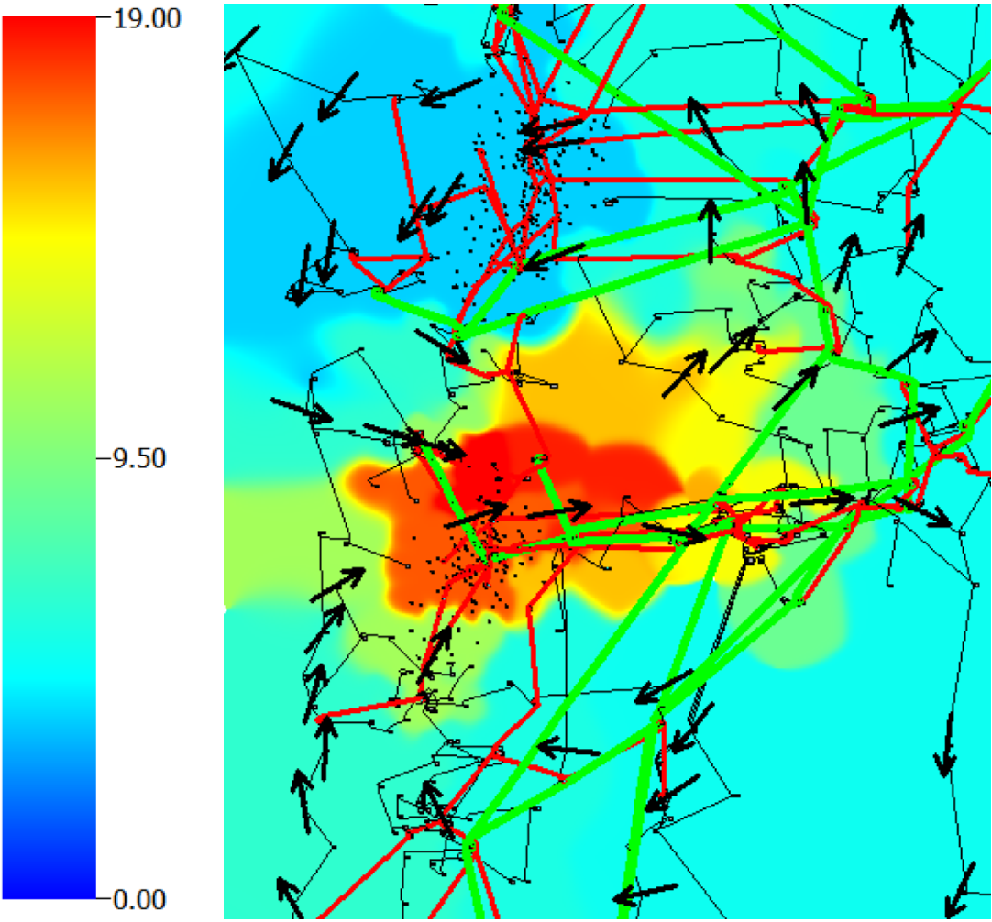
10,000 bus synthetic case
Fig. 5. Contour of “150 km, N1” electric field’s magnitude at maximum intensity. The arrows describe the electric field direction. The elements of the 10,000-bus synthetic grid are also shown.

Slide 17
Summary
Summary
HEMP electric fields originally published under the uniform model were converted to the 1D model
Compared electric field magnitudes for each conductivity region
Compared the effect of both models on an electric grid.
Observation 1
Electric field magnitudes vary greatly between regions
Observation 2
Waveforms could be affected much differently by the same region
Observation 3
Uniform model tends to be conservative, but not always
Observation 4
High rise-time results in higher voltage drop
Observation 5
Sustained high levels of electric field result in sustained GIC’s

